Slide 1
Launton Boys FC AGM 14th of July 2022

Slide 2
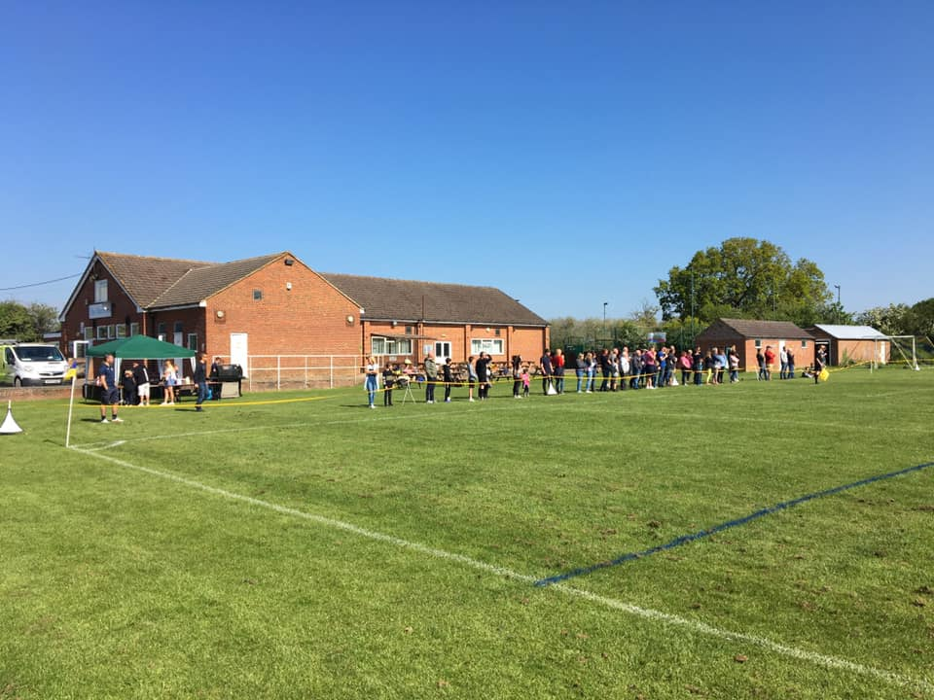
Agenda
Chairman’s Report
AGM Meeting Minutes 2021
Treasurers Report
Subscription Fees
Spending Options
Election of Committee
New Roles / Continuity Planning
Welfare Update
Whitelands / Cooper – Winter Training
Pitch Layouts (Launton & MOD)
MOD Update
Player Registrations (WGS / Club Website)

Slide 3
Chairmans Report

Slide 4
Treasures Report
Accounts
Fees
Spending options

Slide 5
Election of the Committee
Accounts
Fees
Spending options

Slide 6
Whitelands / Cooper Update
We have more teams than we do training slots.
Been a couple of meetings with BTC who are taking over management of Whitelands.
2022/23 Status quo being maintained in terms of carrying over last seasons bookings. This puts us at a disadvantage but lines of communication are open.
Cooper School (CDC) seems to be suffering from staffing issues and its not clear whether this will be resolved by October when winter sessions start.
Do we consider generator driven floodlights for MOD? What price?

Slide 7
Launton

Slide 8
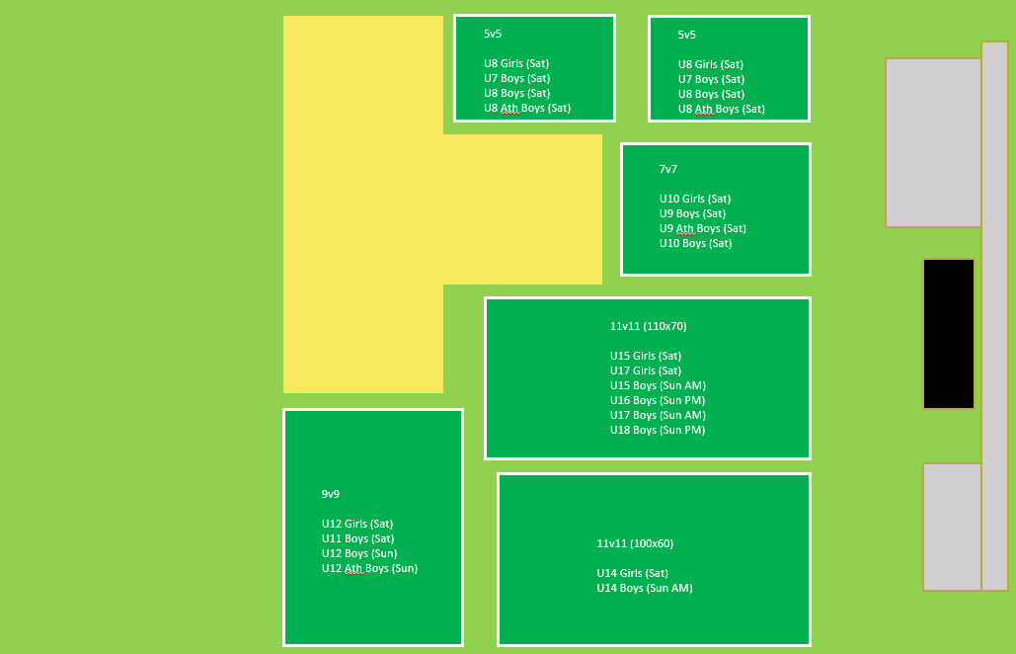
MOD

Slide 9
MOD Update
Spending since March 2021 has not been insignificant, but one of the reasons we embarked on this partnership was because of uncertainty around council pitch availability
Initial scarifying, cutting (Continental Landscapes).
Maintenance throughout the season. Phil has been hugely valuable to the club.
Close season 2022 – seeding and fertilising 11v11 pitch areas. Phil now has a new finishing mower and will be using that between now and beginning of the season to keep grass cut and encourage further growth
Cost to hire will now kick in at £200 per month.
Cost to maintain (by Phil) will cost £150-£200 a month

